Slide 1
Drone Phenology Monitoring
Gaurav Rajput
Parth Thakur

Slide 2
Overview
Tracking individual tree crowns across multiple drone orthomosaics (time points) using a graph-based approach
Temporal monitoring of trees

Slide 3
Workstation Status
WSL stores Ubuntu in a special virtual disk format, so it took 2-3 days to figure out how to recover files from Ubuntu.
Since Disk C in the workstation is full, nothing can be stored there, so we had to choose another drive for storing files, which also took time.
Decided to use TeamViewer instead of SSH.
Downloads are stored in Disk C by default, so we needed to change the default download location to download TeamViewer.
VS Code generally stores its extensions in Disk C, so we need to change that location as well and then everything will work fine

Slide 4
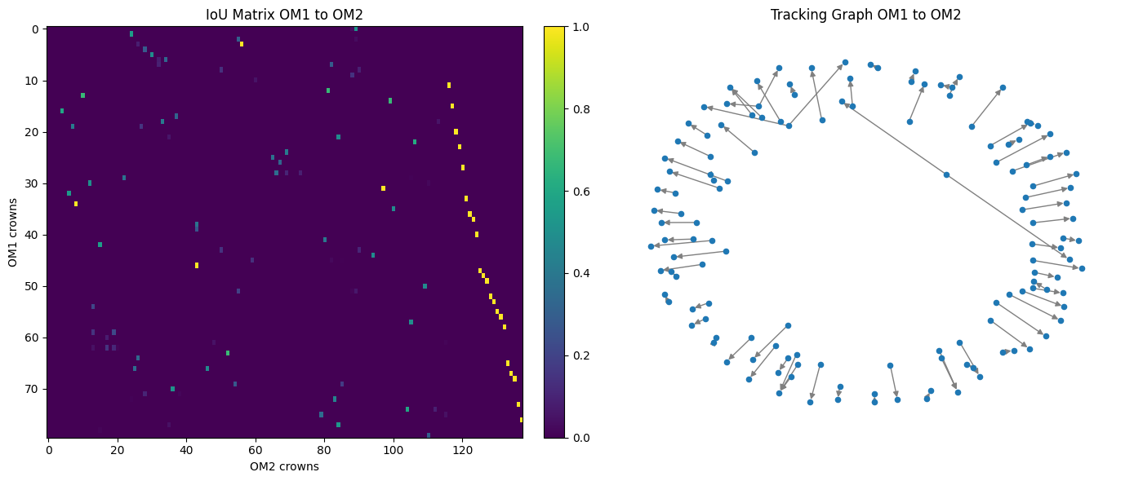

Slide 5
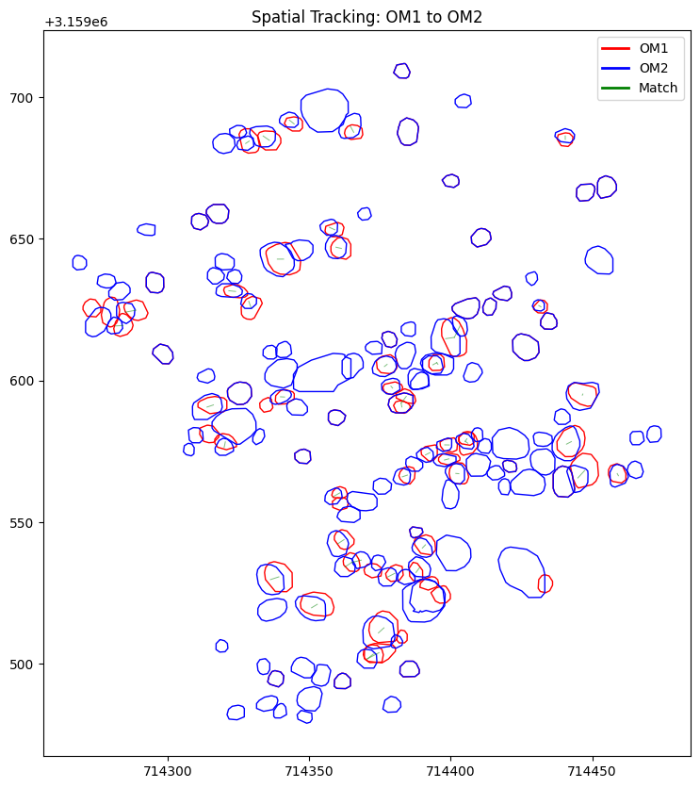
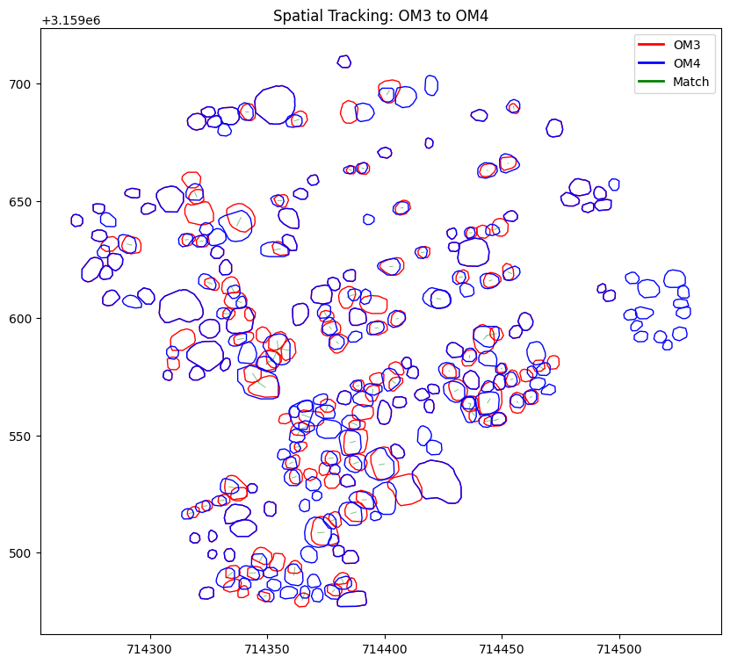

Slide 6
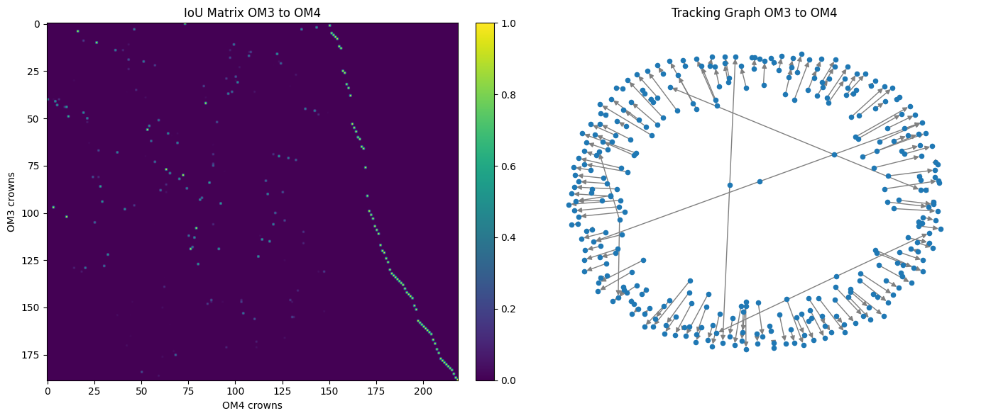

Slide 7
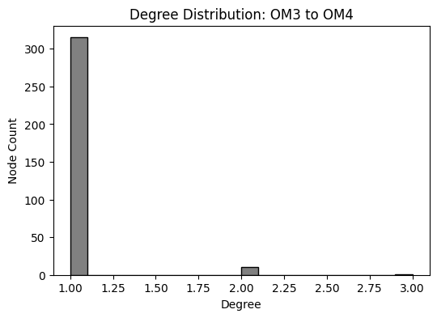

Slide 8
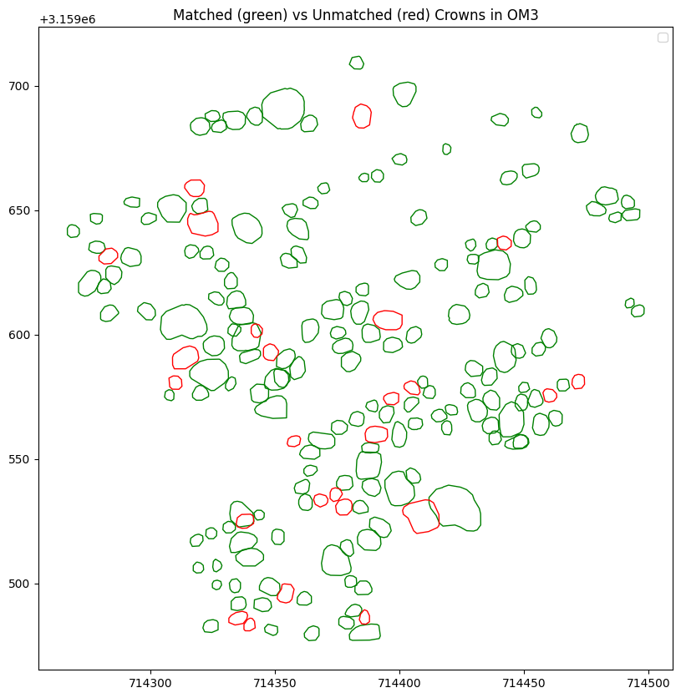

Slide 9
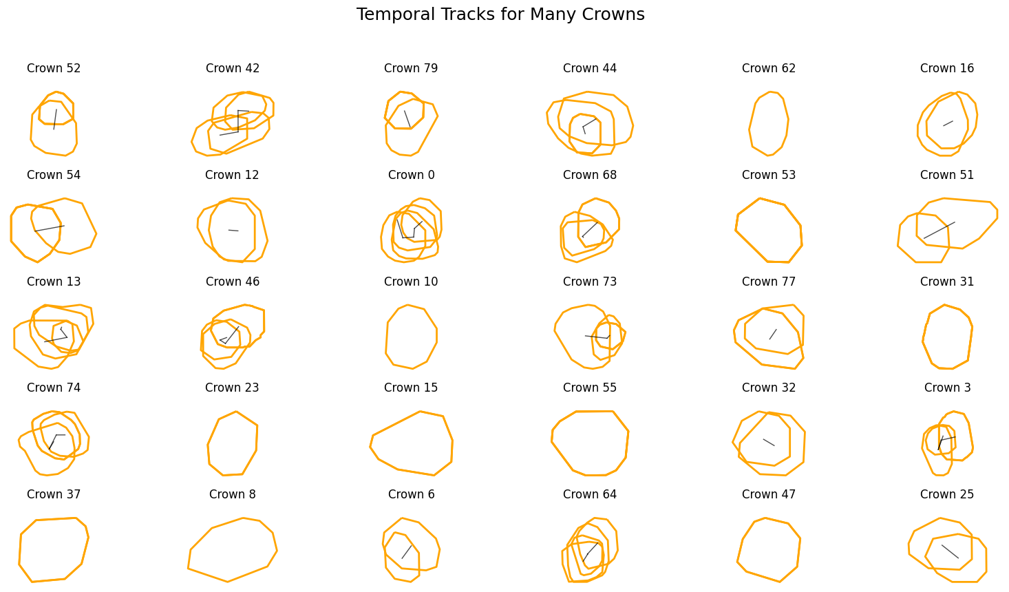

Slide 10
Transition | 1-to-1 Matches | 1-to-Many Splits | Many-to-1 Merges | Disappearances | Appearances | Ambiguous/Overlapping | Total Crowns OM1 | Total Crowns OM2 | Total Edges | IoU Mean | Out-degree Mean | Out-degree Max | In-degree Mean | In-degree Max
OM1 to OM2 | 60 | 3 | 3 | 10 | 69 | 0 | 80 | 138 | 73 | 0.629 | 1.04 | 2 | 1.06 | 3
OM2 to OM3 | 90 | 6 | 6 | 33 | 84 | 3 | 138 | 189 | 111 | 0.683 | 1.06 | 2 | 1.06 | 2
OM3 to OM4 | 150 | 5 | 6 | 25 | 57 | 4 | 189 | 219 | 169 | 0.706 | 1.03 | 2 | 1.04 | 3
OM4 to OM5 | 151 | 8 | 8 | 53 | 83 | 9 | 219 | 251 | 176 | 0.709 | 1.06 | 3 | 1.05 | 2

